Slide 1
WHAT ARE HERDERS AND WHY DO WE BURN THEM?
3 November 2014
Fairbanks ASPE
Dr. Robert A Perkins, PE

Slide 2
Herders

Slide 3
Catch Them

Slide 4
Burn Them

Slide 5
Thickening Agents
Used to increase the thickness of oil spilled on water
  Aid recovery of oil
  Aid burning
    AKA in situ burning
Oil spill remediation
Why is it important?

Slide 6
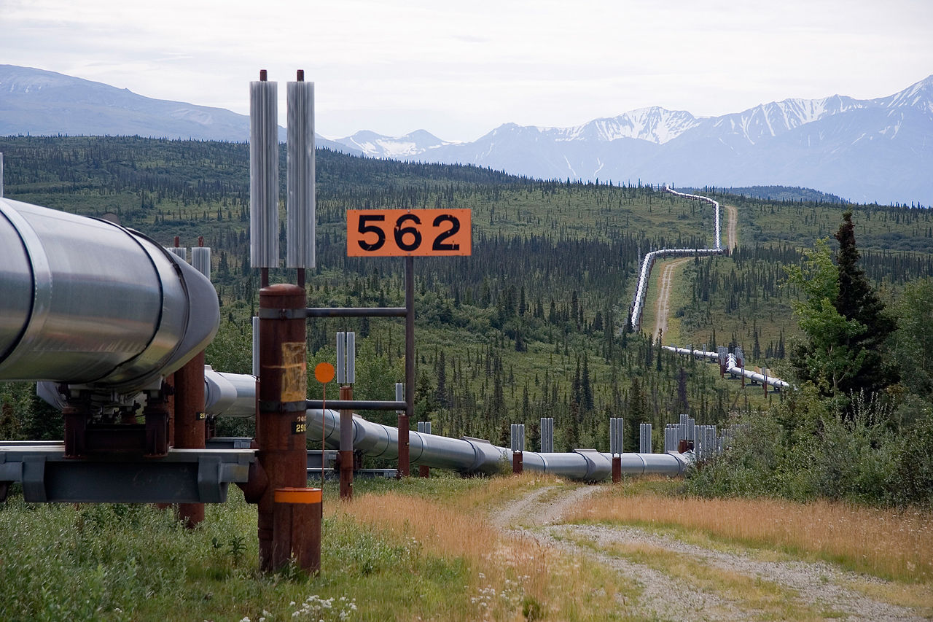
Half empty or half full?
Luca Galuzzi (Lucag) - Photo taken by (Luca Galuzzi) * http://www.galuzzi.it from Wikipedia

Slide 7
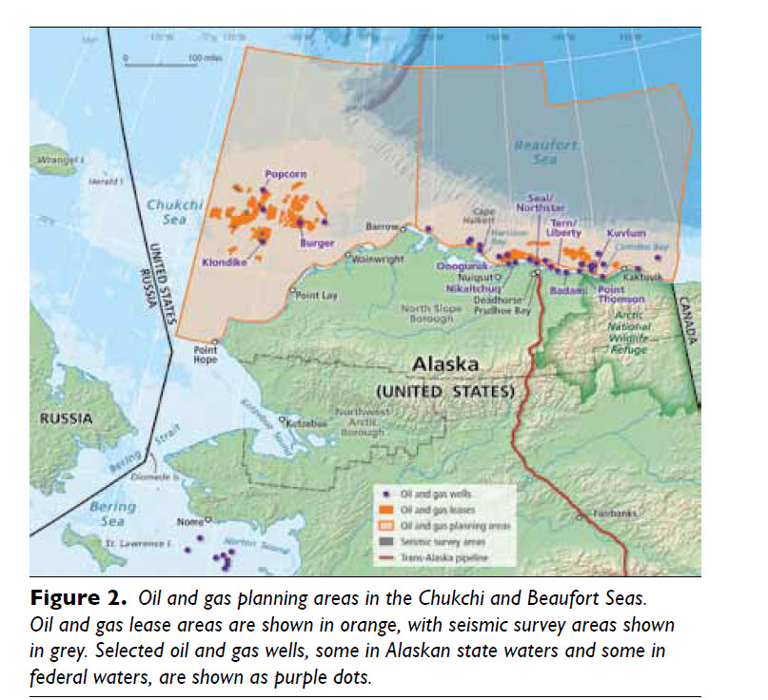
30 billion bbl
NAS NRC April 2014
Notes:
A little math, 30 billion diviide by 2 million bbl/ day/365 days per year = 41 years of full pipeline

Slide 8
Why Not?

Slide 9
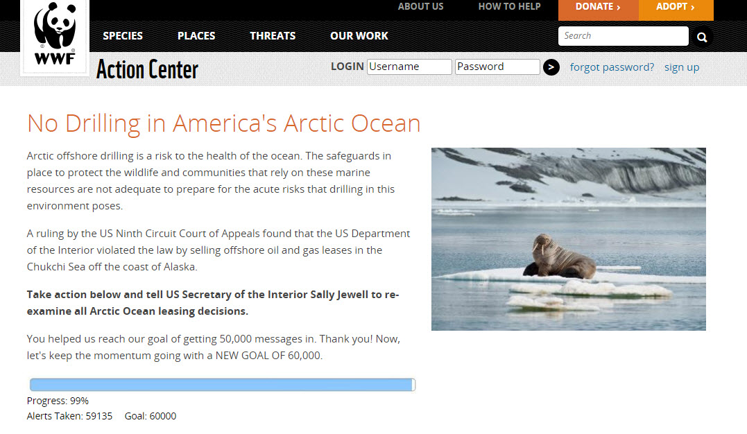

Slide 10
National Research Council
Mounting an effective oil spill response …. in Arctic waters present an even greater challenge.
Extreme cold, rough seas, and darkness in winter months, ….remote location and a lack of infrastructure, equipment, and trained personnel.
Many aspects of the Arctic environment— including the presence of sea ice— an influence the behavior of spilled oil, yet most spill response technologies were designed for and tested in temperate regions.

Slide 11
Oil Spill Response, NEBA
Do nothing, AKA
  Natural processes
  Physical dispersion
Mechanical Recovery
Chemical Dispersion
Burning
  In situ burning, ISB
NEBA, net environmental benefit analysis

Slide 12
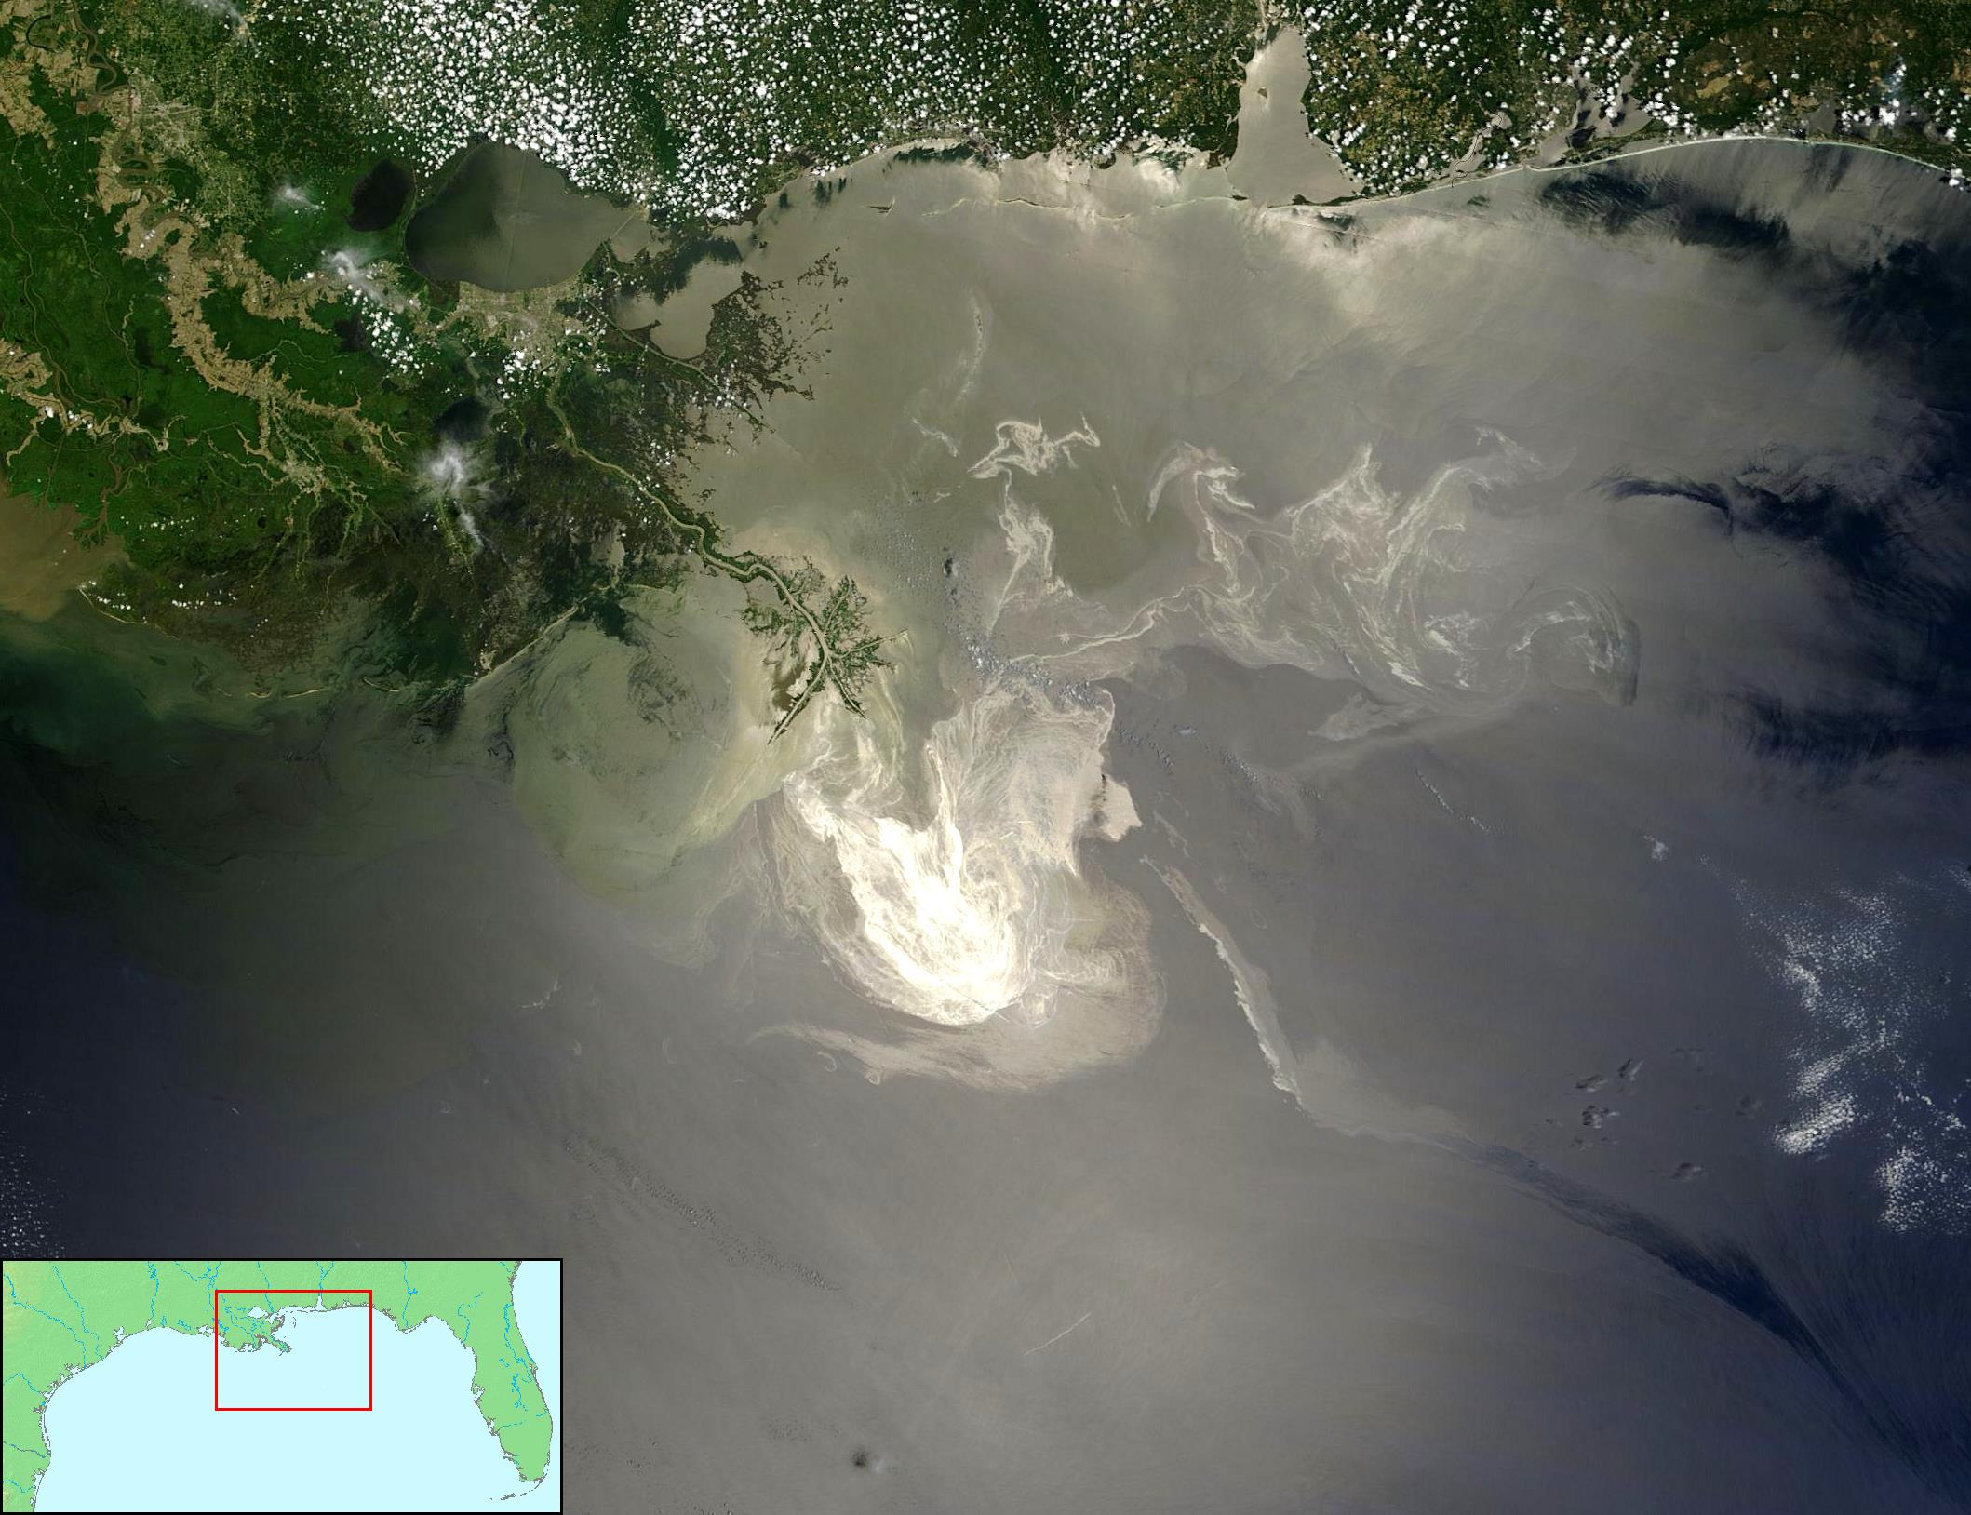
Oil Fate

Slide 13
Fate and Transport
Most products and some light crudes
  Disperse rapidity
Weathering
  Lighter ends volatilize and dissolve
  Heavier remain

Slide 14

Bacteria Love Oil
Burn for energy
Use for biomass = new bacteria

Slide 15
Mechanical Recovery
AKA Skimmers
Oil-water separators
Oleophilic fabric
  Wring out
Large quantities of water
“Encounter rate”
Method of choice, if feasible

Slide 16
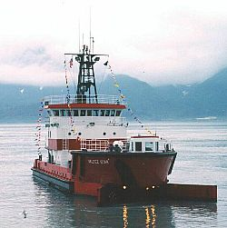

Slide 17
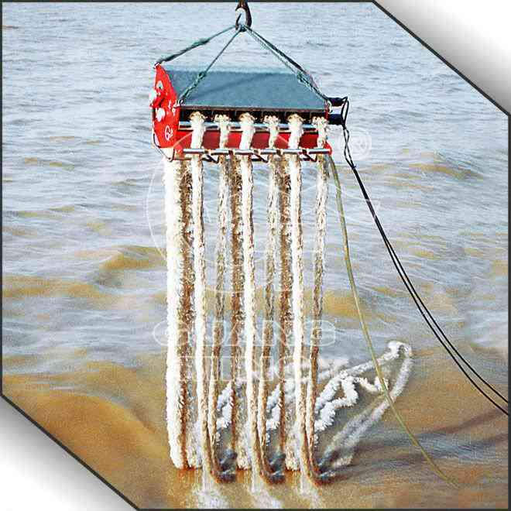
Rope

Slide 18
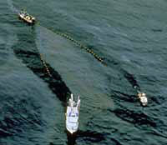

Slide 19
Dispersants

Slide 20
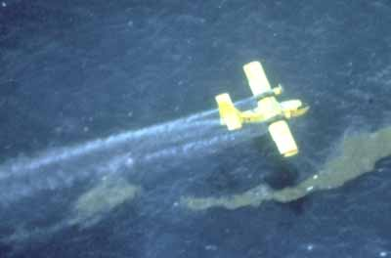

Slide 21
HOW DISPERSANTS WORK
THE GOAL: REDUCE OIL CONCENTRATION TO LESS THAN IMPACT LEVELS AS RAPIDLY AS POSSIBLE

Slide 22
Effectiveness
Type of oil
Weathering state
Sea state and weather conditions
Generally published for major dispersant formulations
Requires “mixing energy”

Slide 23
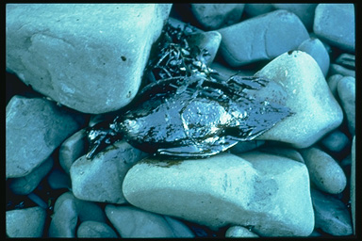
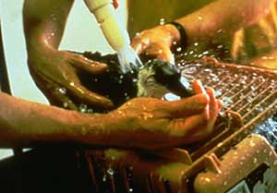
Removes Oil from Surface

Slide 24
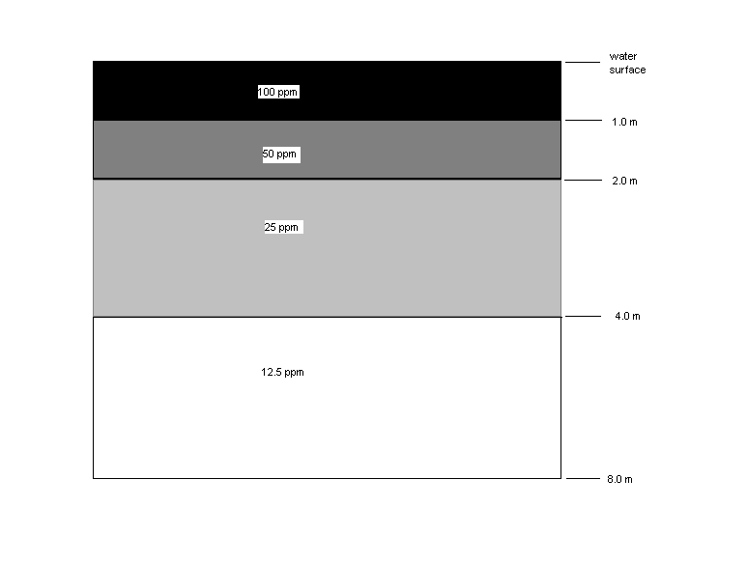
Puts oil into the water column
Fig. 1-9. Concentrations of oil in the water column following dispersal of a 0.1 mm thick slick of fresh oil treated with a chemical dispersant (Lewis and Aurand, 1997)

Slide 25
Are Dispersants Toxic?

Slide 26


Slide 27
Burning
Use fire boom
And boats

Slide 28
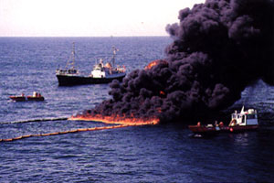

Slide 29
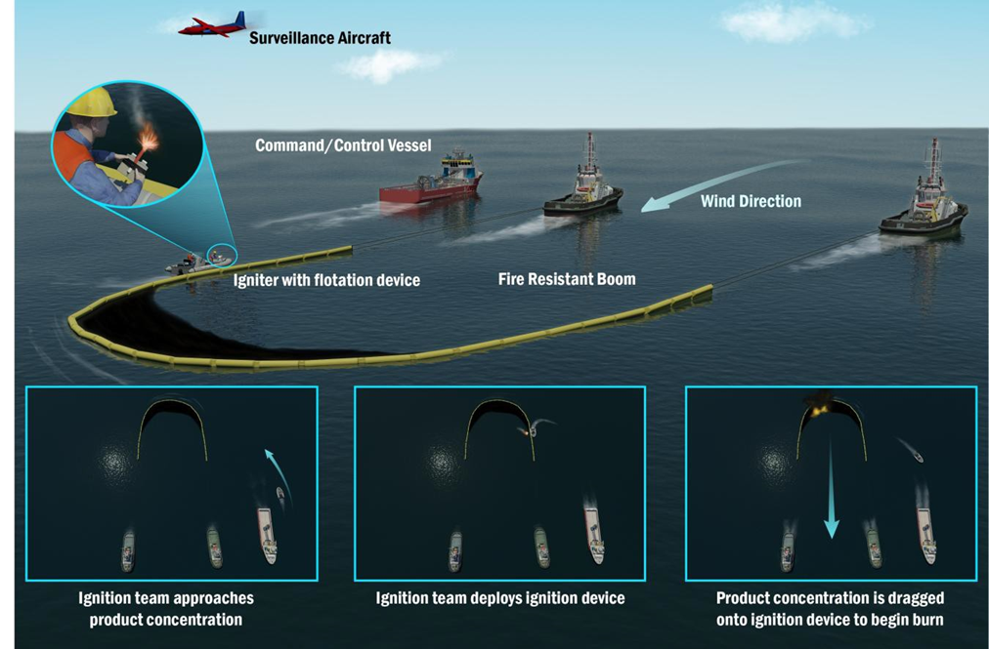
Typical ISB Configuration
(8)

Slide 30
Over 400 “controlled burns” in Gulf cleanup
No worker injuries or safety problems
May not need boom
  Fire pulls oil towards it
  But
Oil must be thick enough
  >5mm will usually burn
  <3mm will often not
  Depending on oil and weathering

Slide 31

Herders

Slide 32
Chemical thickening agents
Navy invented in 70’s
Newer formulations
Spray in very small quantities on the edge of the slick
Reduces oil-water interfacial tension and causes slick to contract
Used for skimmers, but herder itself dispersed with wind and waves
Notes:
Herders sprayed onto the water surrounding an oil slick result in formation of a monolayer of
surfactants on the water surface. These surfactants reduce the surface tension of the surrounding
water significantly (from 73 mN/m to 25-30 mN/m). When the surfactant monolayer reaches the
edge of a thin oil slick it changes the balance of interfacial forces acting on the slick edge and
causes the oil/water and oil/air interfacial tensions to contract the oil into thicker layers. Herders
do not require a boundary to “push against” and work in open (boundary free) water. A
conceptual drawing of the herding process in pack ice is shown in Figure 1. Although
commercialized in the 1970s herders ultimately they were not used offshore because they only
worked in very calm conditions: physical containment booms were still needed to hold or divert
slicks in wind speeds above
2 m/s and breaking waves disrupted the herder layer.
Started to use for skimmers, but skimming takes a long time and wind and waves would disturb and

Slide 33
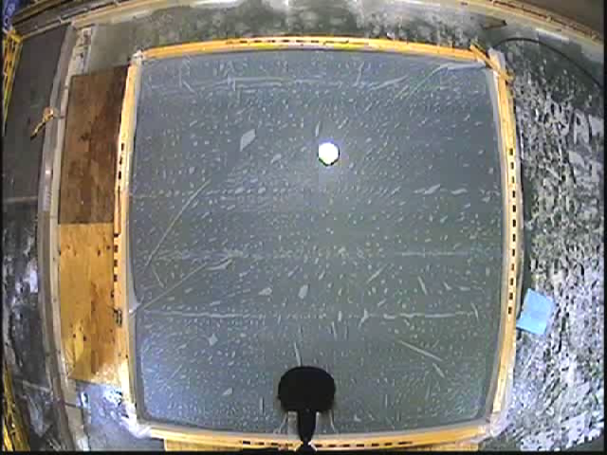
Herders work great

Slide 34
How about the Arctic?
Ice-free waters would not be different chemically or physically from warmer
Logistics and worker safety might be very different, but issues are fairly well-known
How about ice:

Slide 35
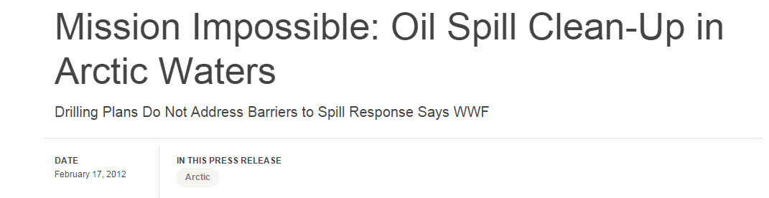
“There is no evidence that oil companies and regulators have fully addressed the obvious lessons from the Deepwater Horizon disaster. Given the difficult working conditions and lack of infrastructure found in the Arctic, it would be irresponsible to begin drilling.”
A recent study on the oil spill response gap in the Arctic’s Beaufort Sea, adjacent to the Chukchi Sea, shows that no oil spill response would be possible for the seven to eight months of winter.
During the remaining four to five months of the year when a response to an oil spill is plausible, high winds, waves, unstable ice and poor visibility would limit the ability to identify, approach, contain and clean-up any spills.

Slide 36
Notes:
July 2014- national academy of sciences= 8 sponsors- industry and government
The National Research Council was asked by the American Petroleum Institute, the U.S. Arctic Research Commission, the Bureau of Safety and Environmental Enforcement (BSEE), the Bureau of Ocean Energy Management (BOEM), the U.S. Coast Guard (USCG), the Marine Mammal Commission, the National Oceanic and Atmospheric Administration (NOAA), and the Oil Spill Recovery Institute

Slide 37
NRC conclusions on Response Measures for the Arctic
Dispersant pre-authorization in Alaska should be based on sound science, including research on fates and effects of chemically dispersed oil in the Arctic environment, experiments using oils that are representative of those in the Arctic, toxicity tests of chemically dispersed oil at realistic concentrations and exposures
In situ burning is a viable spill response countermeasure in the Arctic. ... further research is needed to evaluate improved ignition methods and to explore the use of aerially applied oil-herding chemicals at different spatial scales and with different oil types
Mechanical recovery can provide a viable option for small, contained spills in pack ice, or for larger spills under fast ice; however, response to a large offshore spill in the U.S. Arctic is unlikely to rely only upon mechanical containment and recovery because of its inefficiency
No single technique will apply in all situations.
(NRC, 2014)

Slide 38
Oil in Ice Processes
(5)
Notes:
Exxon, 1990
Arctic Response technology, 2013

Slide 39
http://www.youtube.com/watch?v=2dL3RGwpBaI
Based on 2000 tests

Slide 40
Joint industry program on oil spill contingency for Arctic and ice covered waters
SINTEF
2006-2009
Notes:
A14181. Open
ISBN-nr: 978-82-14-04759-2il in Ice - JIP
Report no.: 32
Stein Erik Sørstrøm, Per Johan Brandvik, Ian Buist,
Per Daling, David Dickins, Liv-Guri Faksness, Steve Potter,
Janne Fritt Rasmussen and Ivar Singsaas
SUMMARY REPORT
REPORT

Slide 41
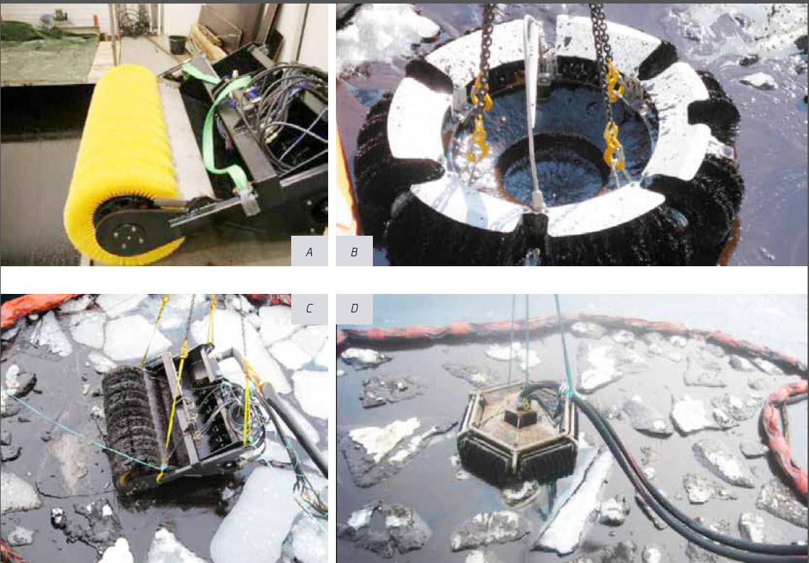
Mechanical

Slide 42
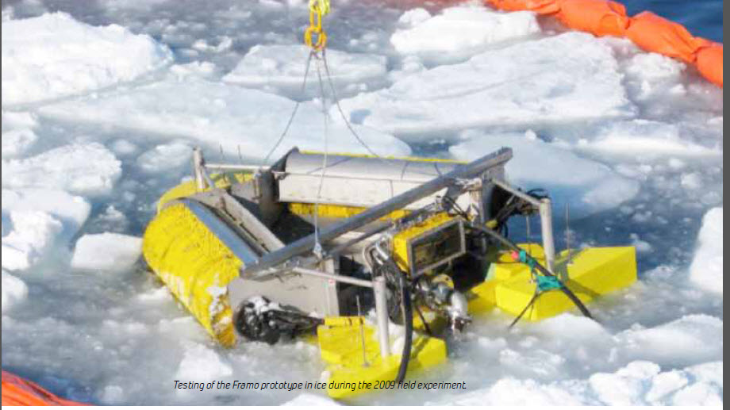

Slide 43
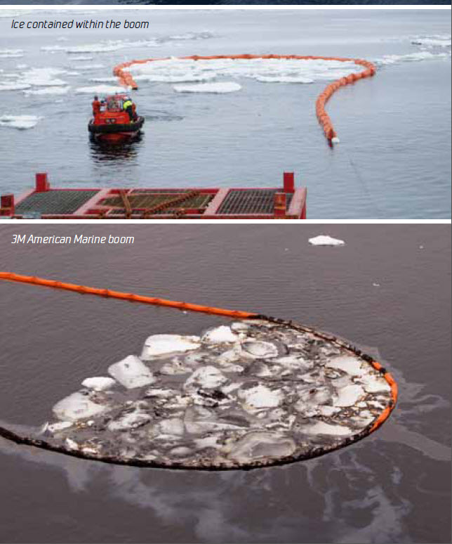

Slide 44
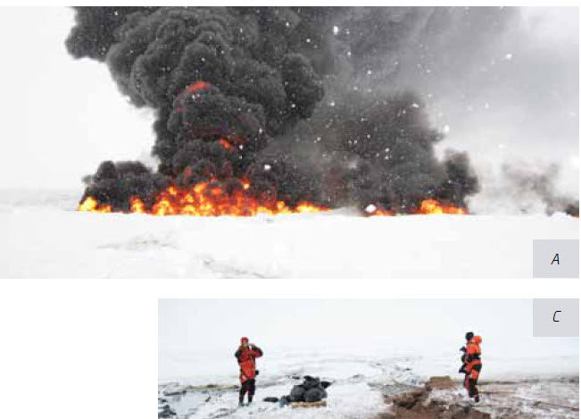

Slide 45
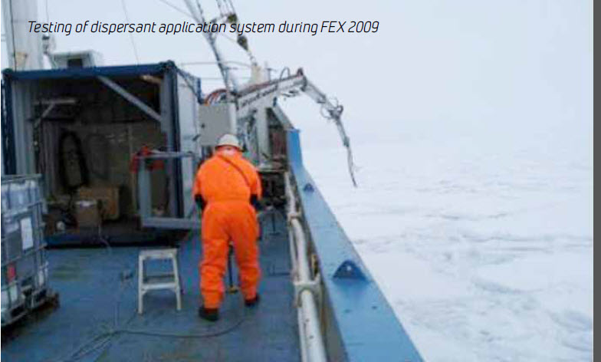

Slide 46
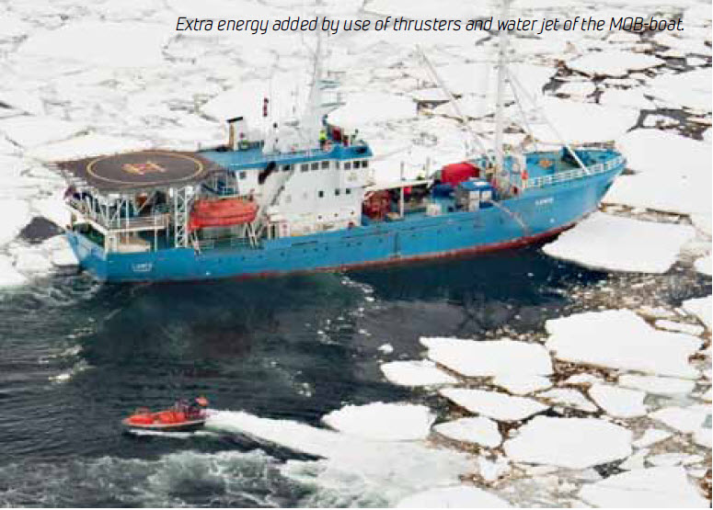

Slide 47
UAF Research
Exxon Valdez
Work with bioremediation
  Joan Braddock and IAB
Much biology
  Many

Slide 48
INE and CROSERF

Slide 49
CROSERF
Chemical Response to Oil Spills: Ecological Effects Research Forum
Or
Chemical Response to Oil Spills: Environmental Research Forum

Slide 50
CROSERF Testing
Standard species and standard oil
  Calibrate labs
Standard species and local oil
  Is our oil different?
Local species and local oil
  Are our local species different?

Slide 51
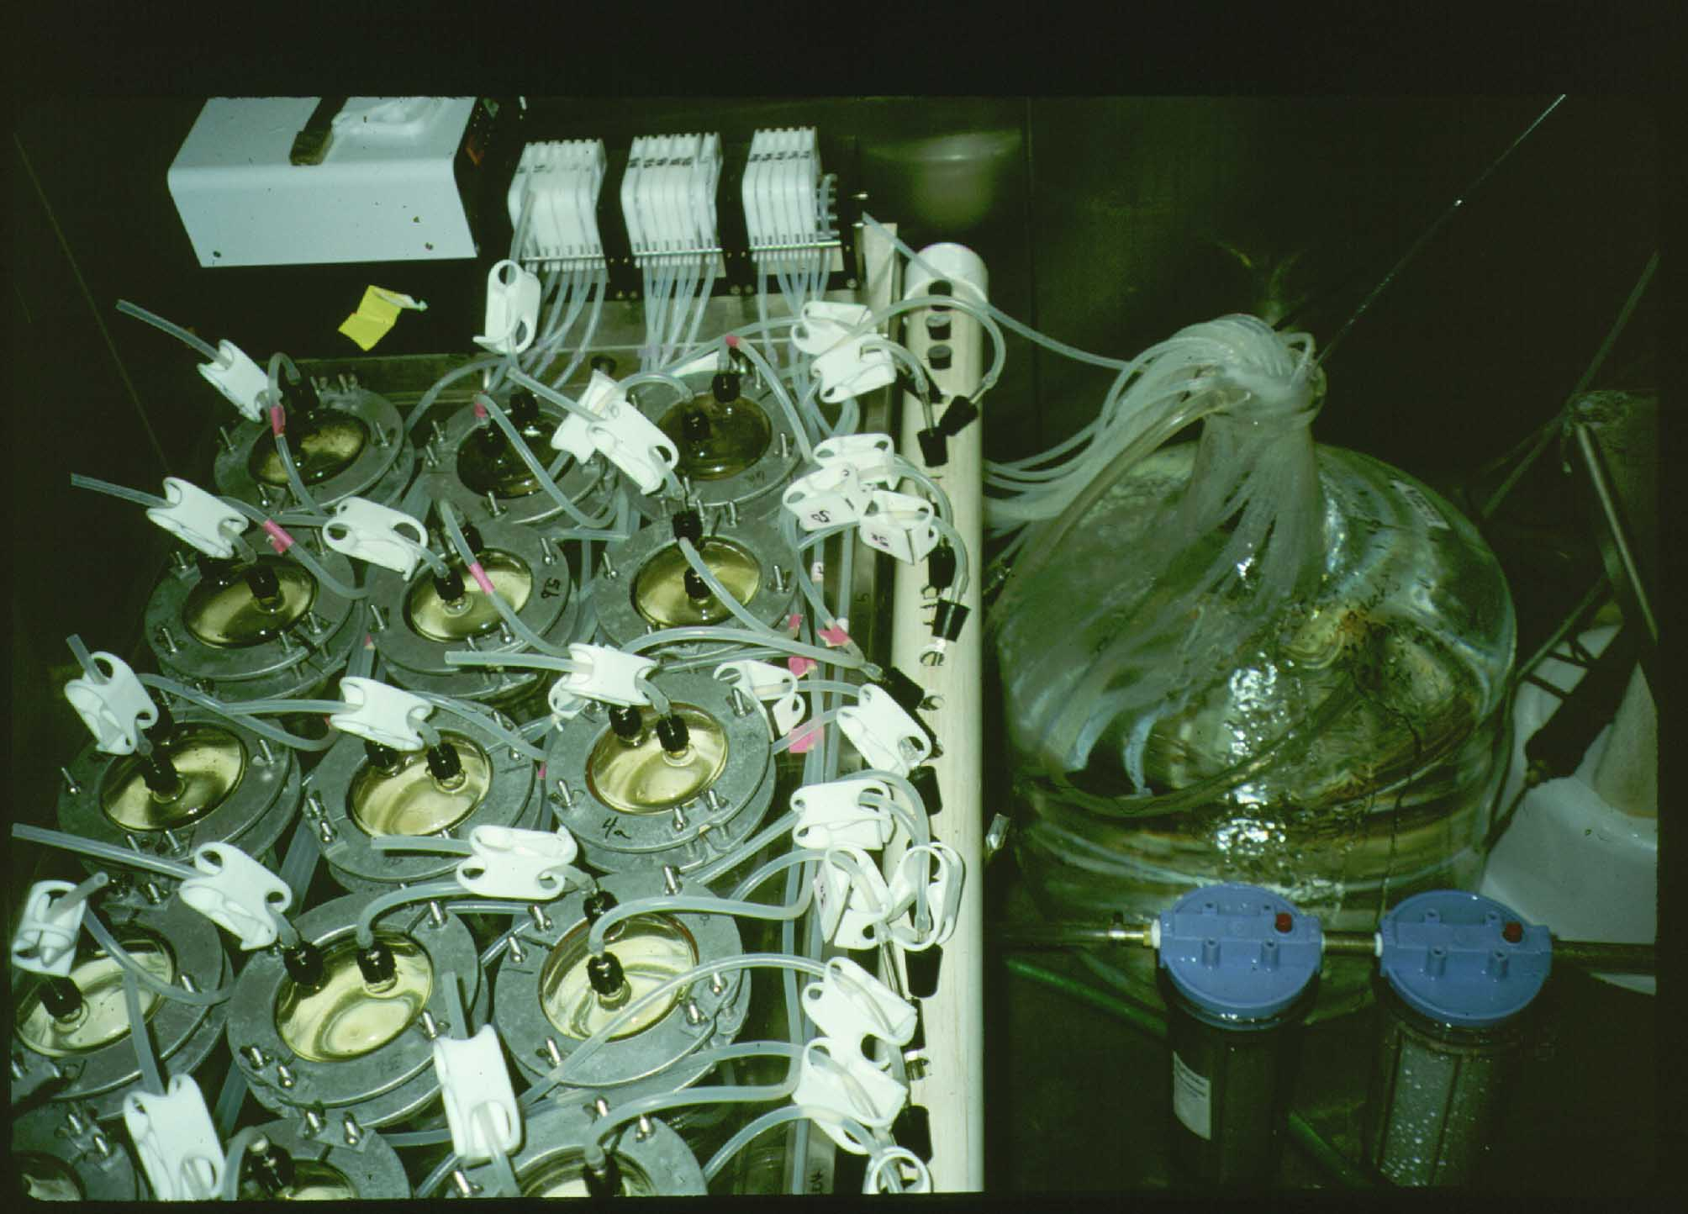

Slide 52
Test Regimes
Species
  Mysid
  Fish larvae
  Tanner crab larvae
  Microtox
Oils
  PBCO
  ANS, Fresh
  ANS, Weathered
    200 deg. C.

Slide 53
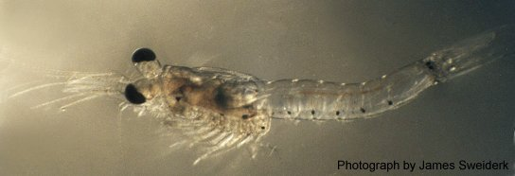
A Tail of Two Tests
Mysidopsis bahia
Photo: Marinco Bioassay Laboratory

Slide 54
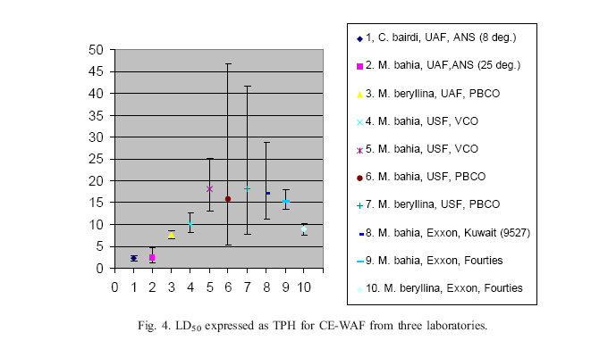
Fresh CE-WAF

Slide 55
INE and IAB
JIP
NewFields, now Port Gambell Environmental Science

Slide 56
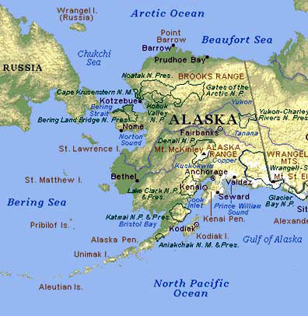
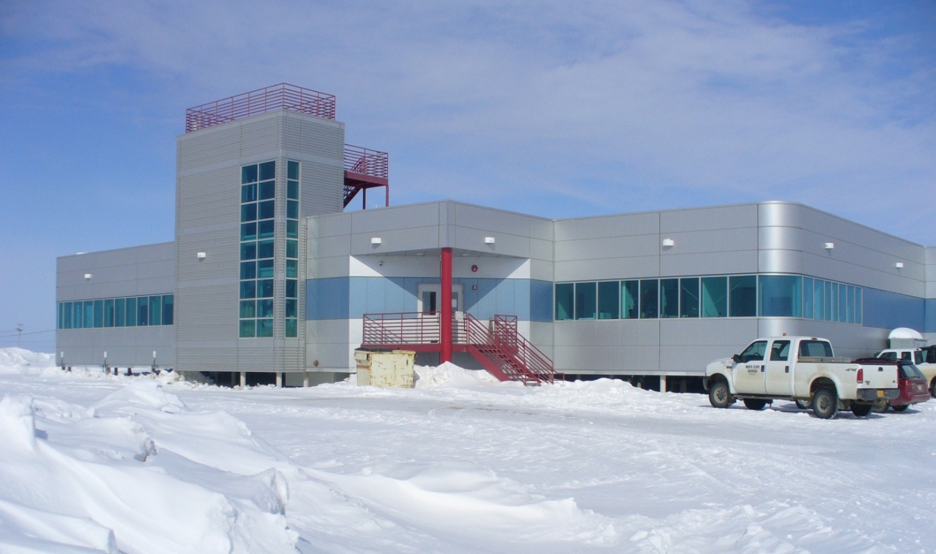
Toxicity and Biodegradation of
Dispersed Petroleum
Research objectives:
Test the effects of oil and chemically dispersed oil on arctic marine organisms
Measure biodegradation rates of oil vs. dispersed oil in arctic seawater
The Barrow Arctic Research Center, Barrow, Alaska

Slide 57
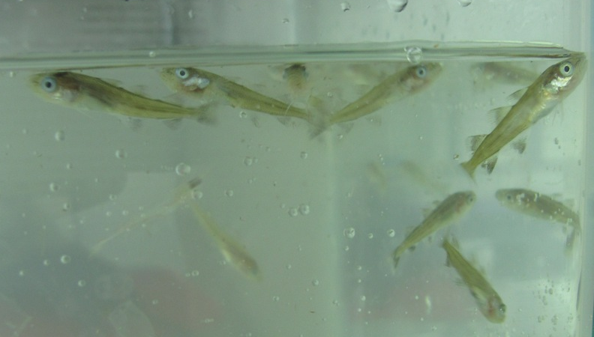
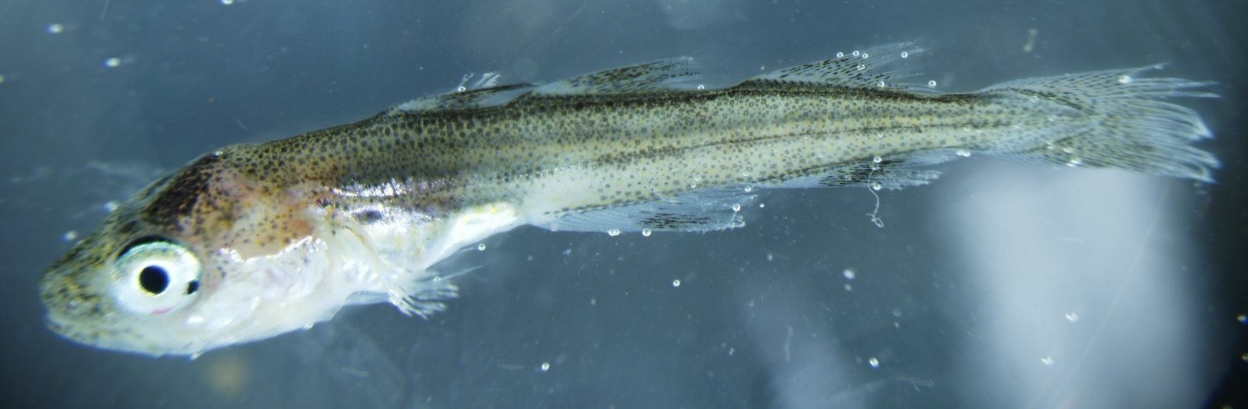
Arctic Cod (Boreogadus saida)

Slide 58
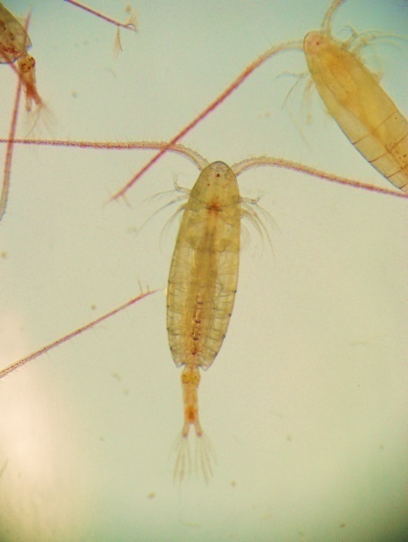
Copepod (Calanus glacialis)

Slide 59
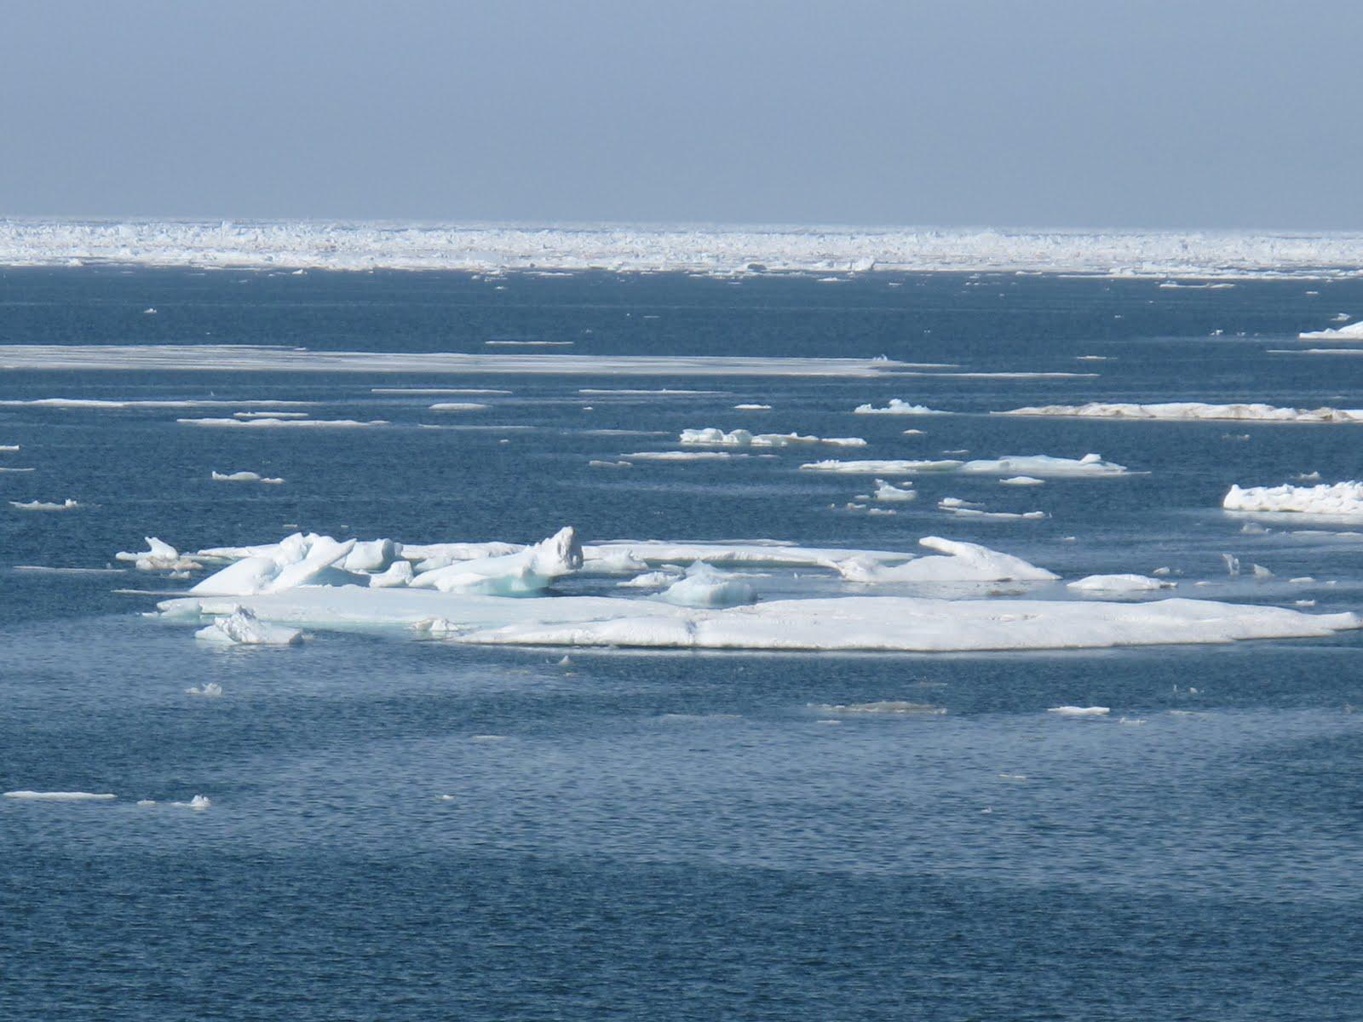
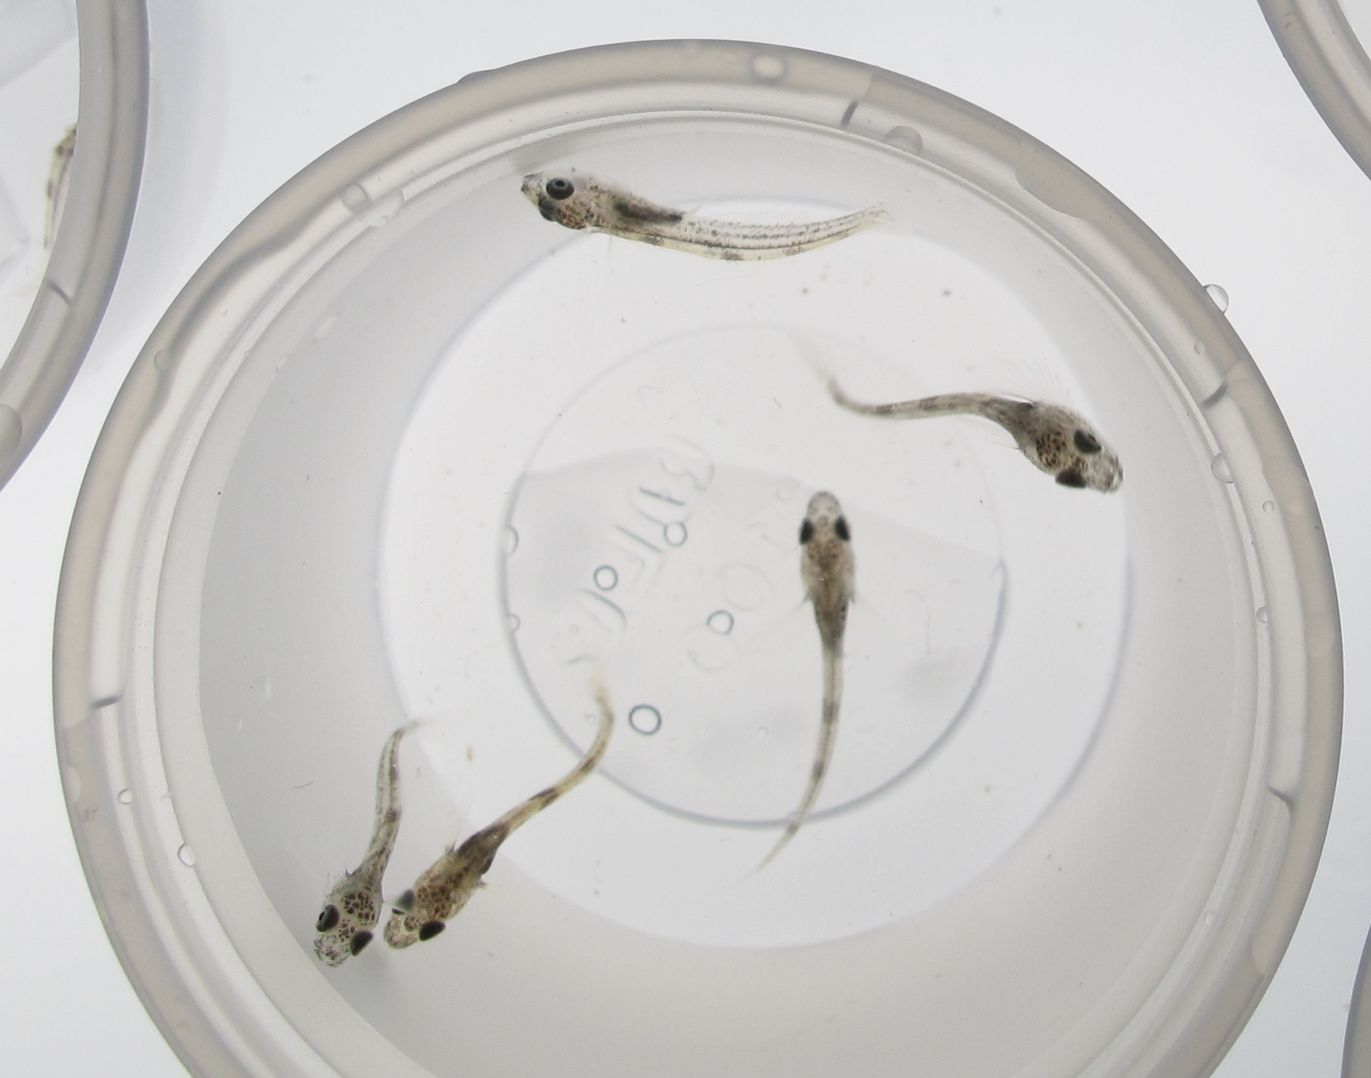
Sculpin (Myoxocephalus sp.)

Slide 60
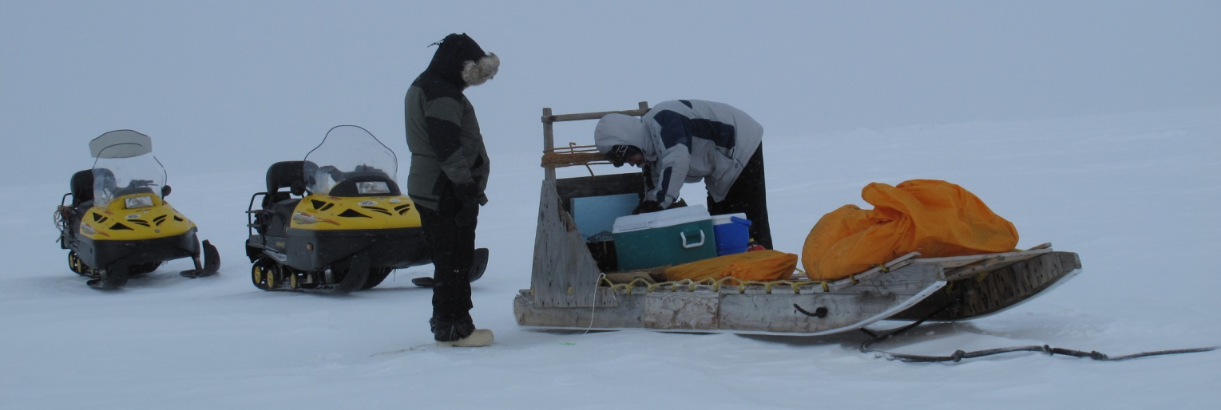
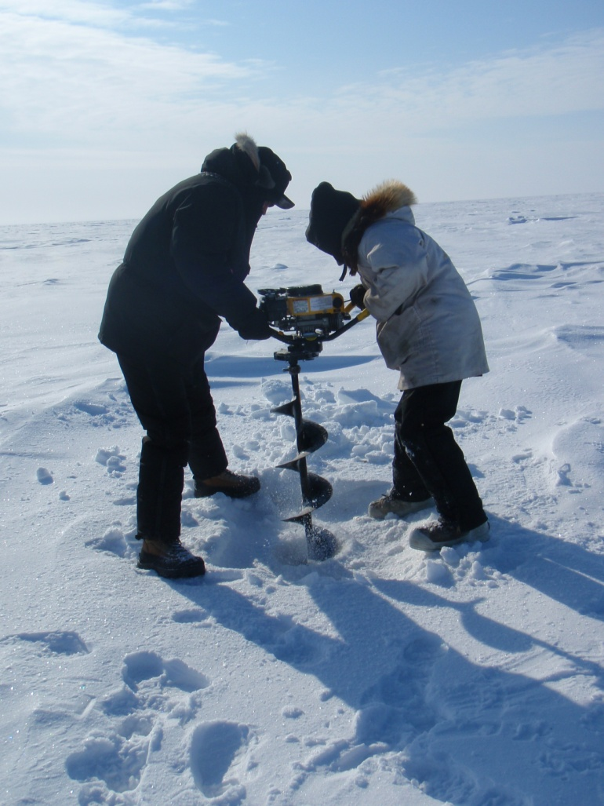
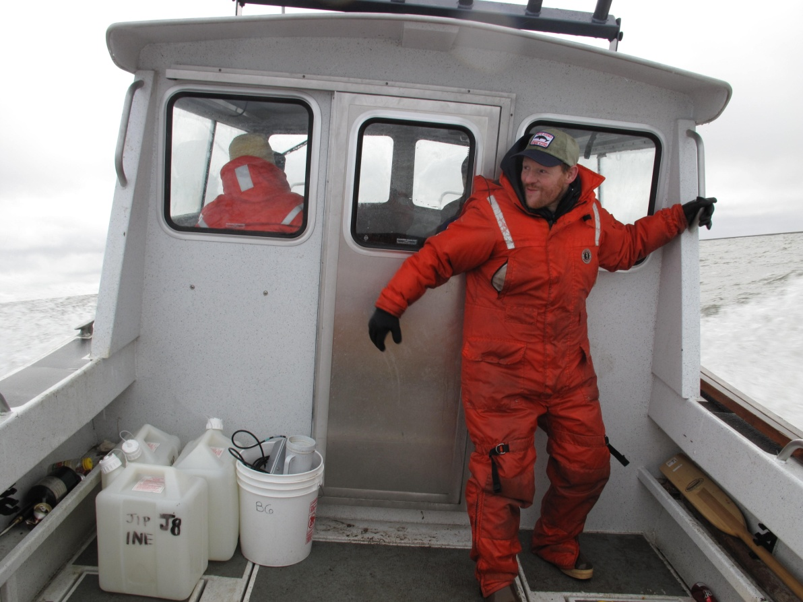
Field Expeditions

Slide 61
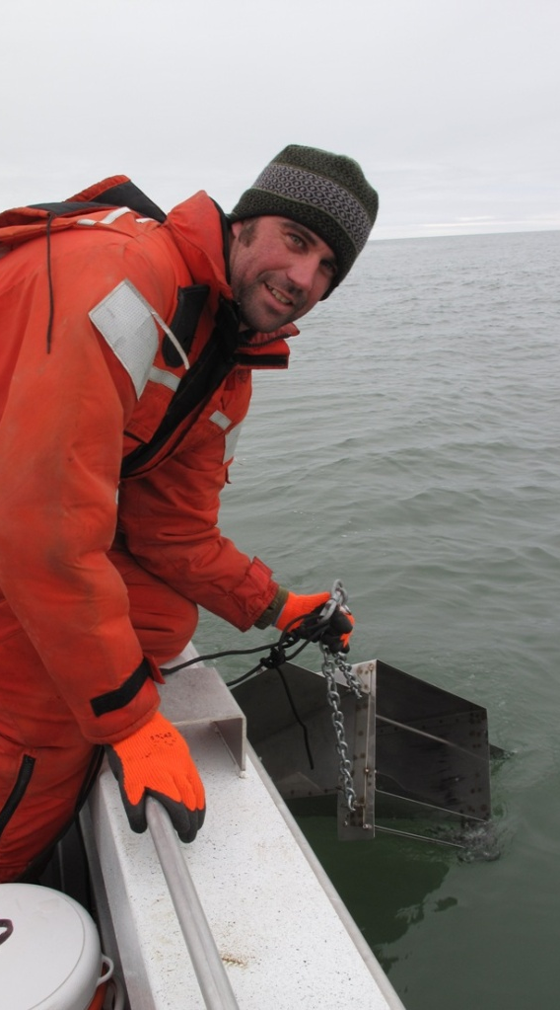
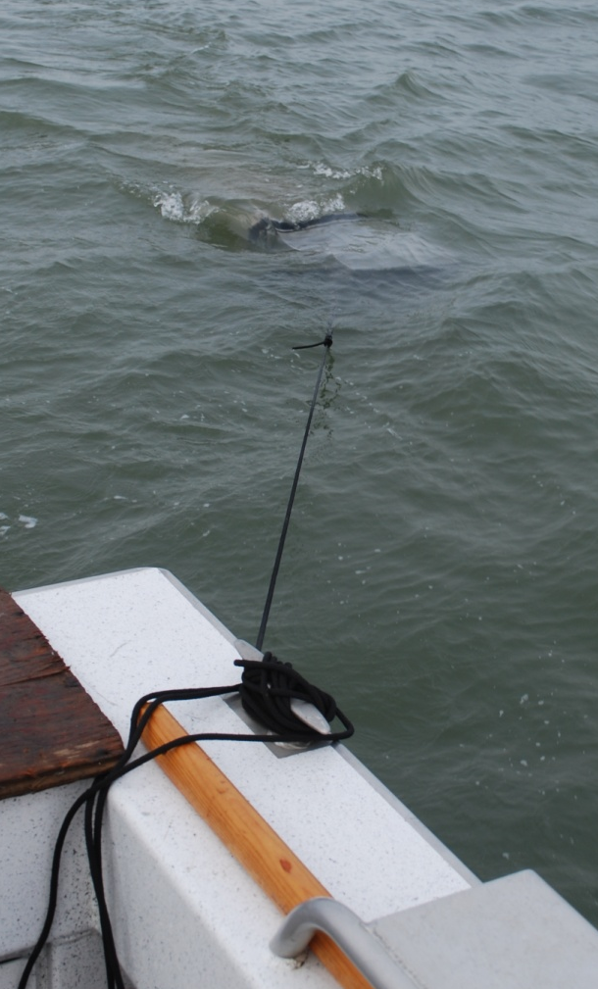
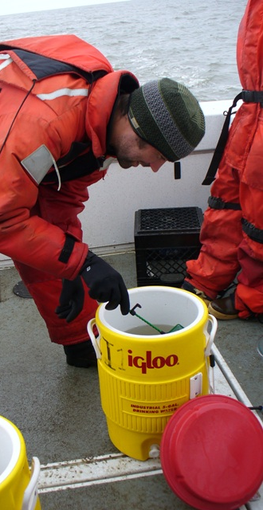
Summer Arctic Cod Collection

Slide 62
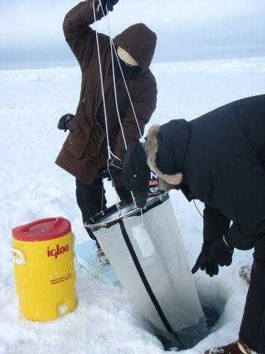
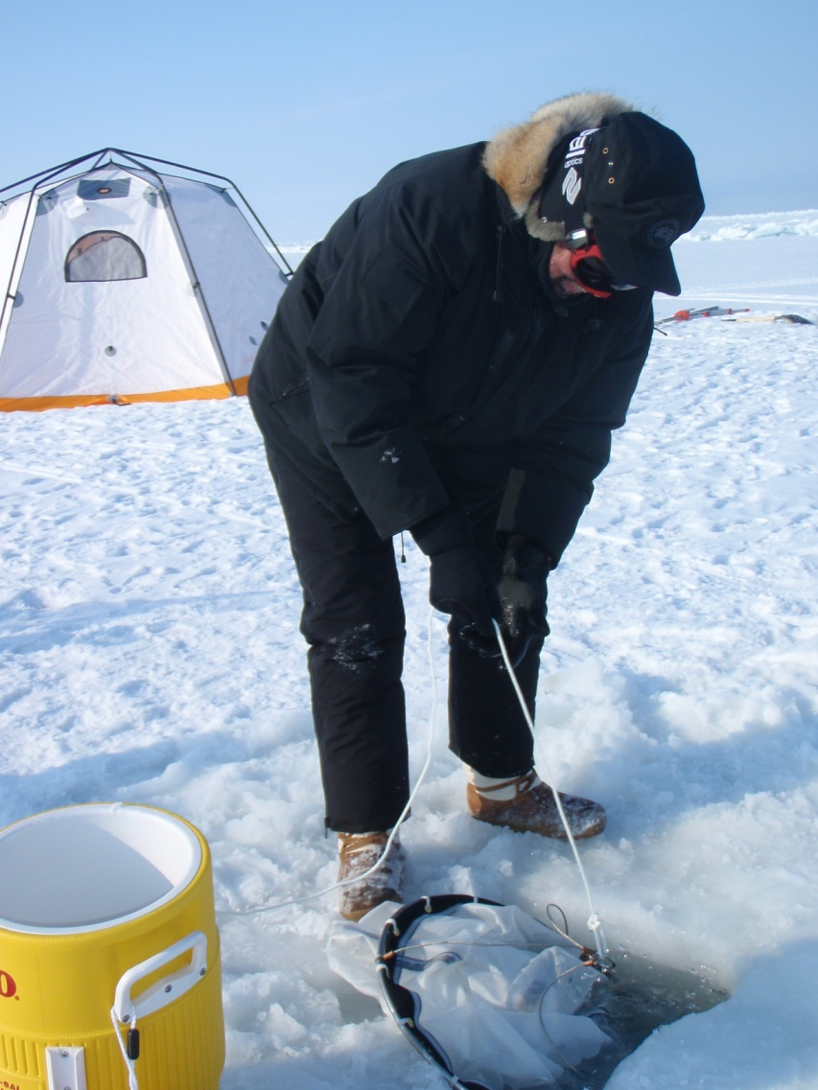
Winter Copepod Collection

Slide 63
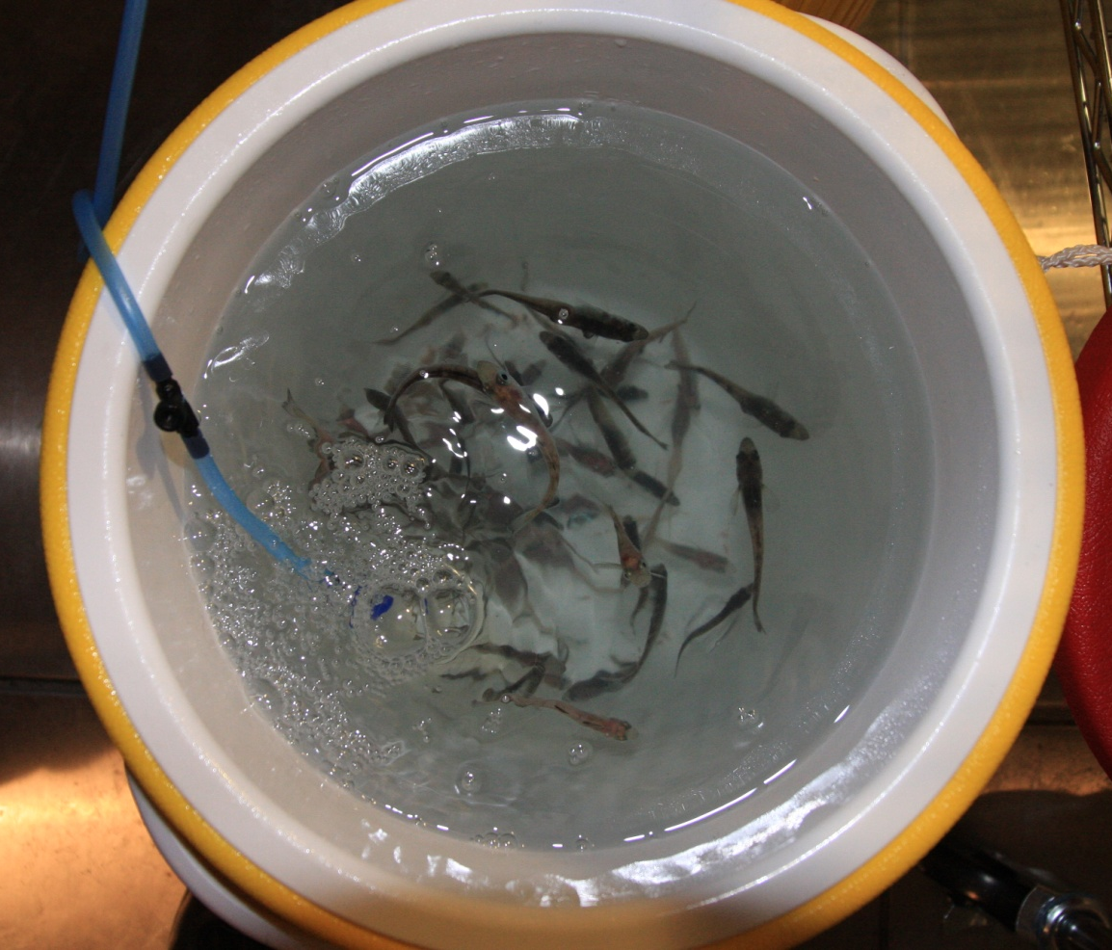
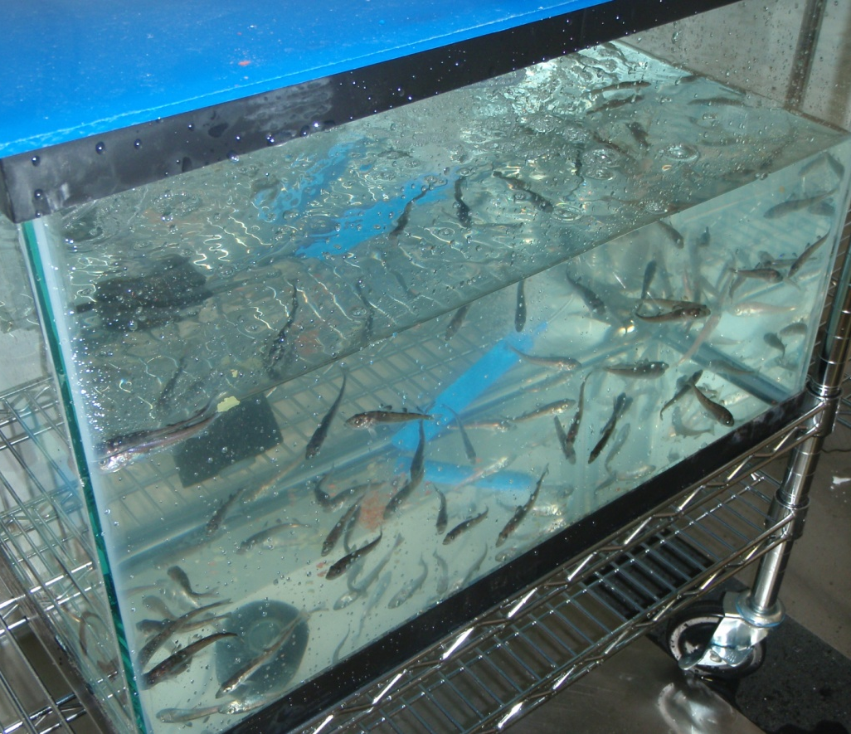
Culture Maintenance

Slide 64
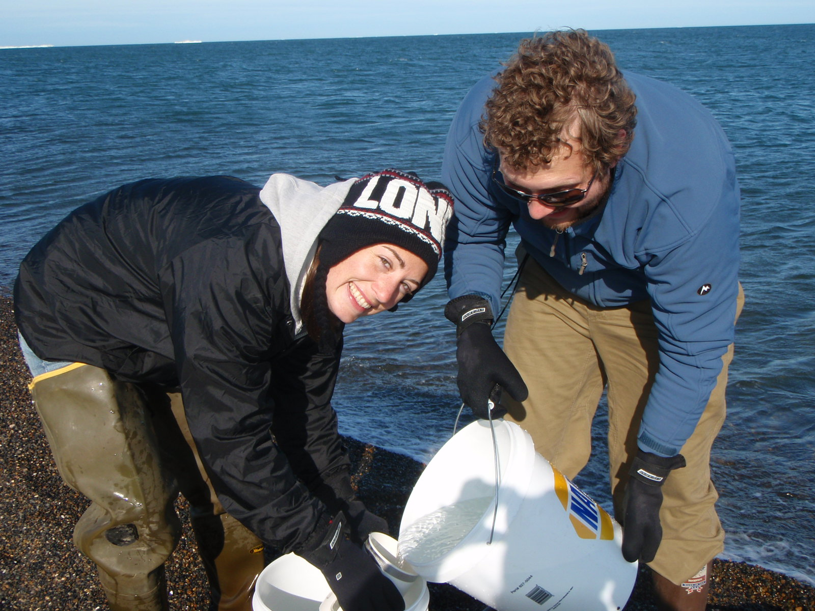
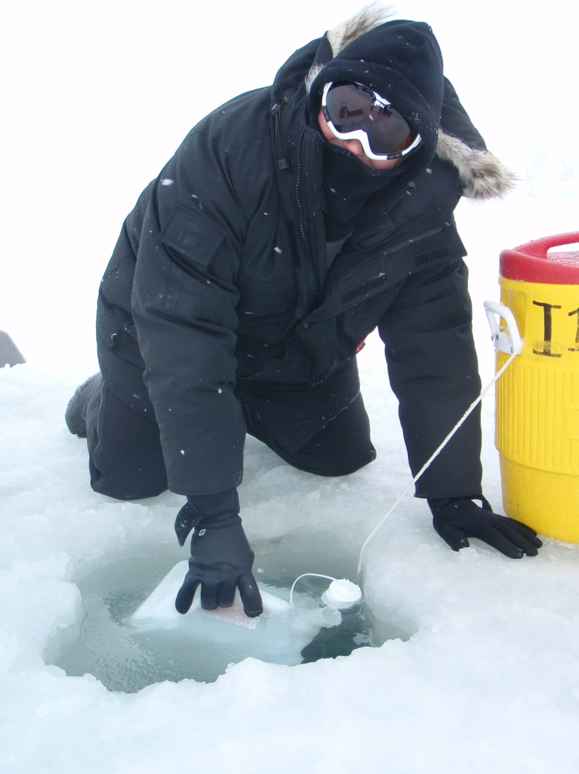
Water Collection

Slide 65
Toxicity Testing
Standard reference toxicity (copper)
Toxicity of dispersed fresh ANS and weathered ANS
Spiked exposure with dilution based on CROSERF
96 hour to 20 day observations
Test were successful and results are currently under review

Slide 66



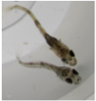









Comparing Arctic and Non-Arctic Species
CEWAF LC50 (mg/L TPH)

Slide 67
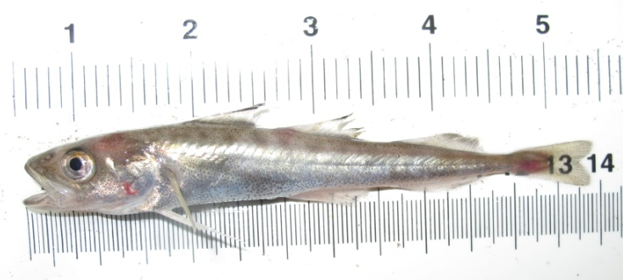
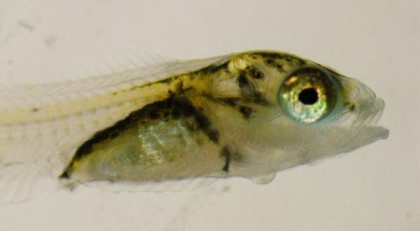
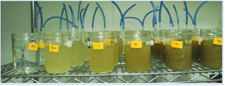
Toxicity of Dispersed Petroleum to Arctic species
Copepod (Calanus glacialis)
Arctic cod (Boreogadus)
Sculpin (Myoxocephalus)
Species selected based upon role in the pelagic food web of the Beaufort and Chukchi Seas
Toxicity tests conducted on ANS crude oil:
  Chemically dispersed (COREXIT 9500)
  Mechanically dispersed ANS crude oil

Slide 68
Comparative Toxicity of Petroleum in Arctic, Subarctic and Temperate Regions
Red Bars show Arctic species response

Slide 69
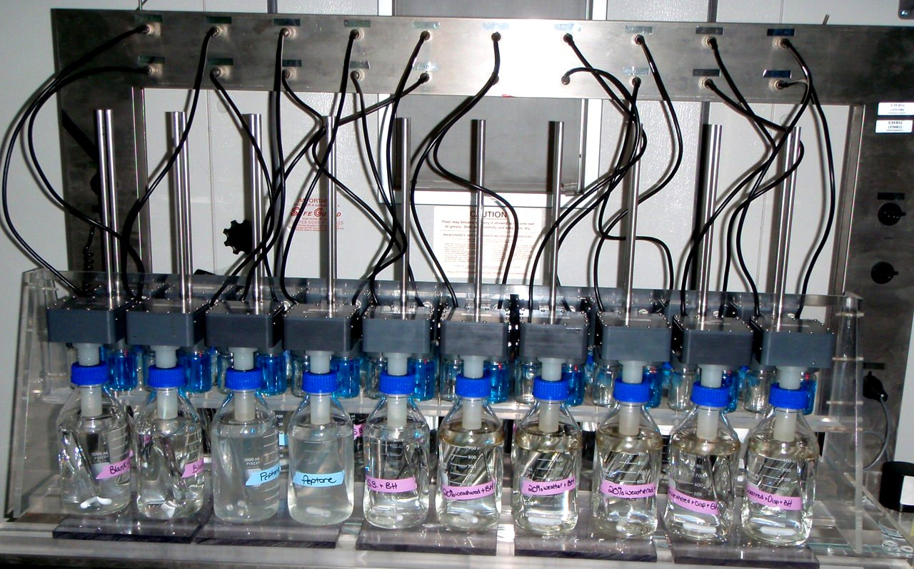
Biodegradation of Dispersed Petroleum in Arctic Seawater
Respirometer, located in a walk-in freezer in Barrow, AK
Biodegradation of ANS crude oil measured by:
  Respirometry - oxygen consumption by microbes over time
  GC-MS analysis - disappearance of petroleum components over time

Slide 70

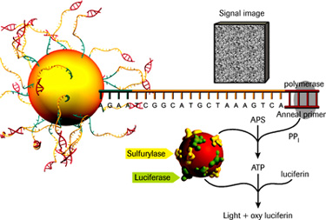
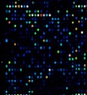
Biodegradation of Dispersed Petroleum in Arctic Seawater
Respirometer, located in a walk-in freezer in Barrow, AK
Assessing biodegradation of crude oil:
  Respirometry - oxygen consumption by microbes
  GC-MS analysis - disappearance of petroleum
  Microbiology – Cutting edge methods for detection of oil degrading bacteria and genes

Slide 71

Biodegradation of Petroleum and Dispersed Petroleum - Arctic Conditions
Respirometry loss estimates total oil while GCMS loss is for hydrocarbon compounds measured by GCMS

Slide 72
Respirometry Consumption of Oxygen
Weathered crude oil in the presence of dispersant uses more oxygen, indicating greater biogenic activity.

Slide 73
Biodegradation of Petroleum and Dispersed Petroleum - Arctic Conditions (after 57 days in incubator) Measured by GCMS

Slide 74


Slide 75


Slide 76


Slide 77
America's Arctic university
UAF is leading the effort with University of Washington, Brigham Young University, and Rensselaer Polytechnic Institute to establish an Industry/University Cooperative Research Center (I/UCRC).
If funded by National Science Foundation (NSF), will begin this five year program with a focus on oil-spill related research and education.
The NSF I/UCRC program was designed to foster research relationships between industrial and academic partners, focusing on directly applicable science and technology solutions for a given industry.

Slide 78
UAF Research Expertise
Projects in progress, or
Proposed

Slide 79



SFOS/UAF Autonomous Remote Technology lab
Operates three Webb Slocum Autonomous Underwater Vehicles (AUV) gliders
Non-propelled, autonomous, quiet, low-power, long-endurance specific AUV →
up to ~ 3 month missions using lithium batteries
Two-way real-time Iridium satellite communication → mission change on the fly + relay data to scientists, numerical models and decision makers
Unique, high-resolution (vertical and horizontal) surface-to-bottom data coverage

Slide 80


2010 deployment show that the AUVs are able to successfully navigate large portions of the Chukchi Sea, including offshore lease patches for months at a time
UAF is the only academic entity operating gliders (and HF radar) in the Arctic - Unique capability

Slide 81

Coastal Radars map surface (upper 1 m) currents:
- hourly
over broad areas (~175 km) at
  6 km resolution
realtime access via web access
easily understandable
cost effective
To guide:
Response to marine spills
Search and rescue operations
Evaluate spill models
Vessel-tracking
To understand:
Ocean Dynamics
Marine Ecosystems
~4MHz
Shore-based power available

Slide 82


Remote Power Module and HF Radar:
Barrow, Fall 2010
Most of coastal Alaska does not have power!!!
We have built and tested an autonomous power system (wind, solar, & biodiesel).
scaleable, portable,
arctic-proof.
8 radar-RPM systems would cover North Slope and NE Chukchi Sea (40,000 n.mi.²)

Slide 83


Real-time currents for determining underice oil spill trajectory
(landfast ice zone only)

Slide 84





SPILL MONITORING
IN ICE-COVERED WATERS
Barrow
Notes:
Main points:
coastal radar great for monitoring within 10km of platform or shore-sites
2) buoys deployed on ice after spill can help track potential oil trajectory over long distances
Top left: UAF researchers deploying ice drift buoy (ARGOS positioning)
Top right: drift from Jenny’s buoys (start April; end June; 7 days between cross-hairs, bunch in center near ice camp which was ~190 mile north of Prudhoe Bay; most southern drift shows > 50km in 7 days!); assuming oil moves with ice, if oil gets out into the Beaufort Sea, could spread >50km in a week
Bottom left: Barrow coastal radar
Bottom right: air drop ice buoy developed by Canatac and used by UAF (check with Jenny), position updated every few minutes (ARGOS = 4 hrs)

Slide 85



OIL TRAJECTORY MODELING IN ICE-COVERED WATERS
Products
Predicting
Daily to weekly forecasts for spill response and planning
Modeled oil spill trajectories based on key spill scenarios for EIAs and risk assessments
Evaluate the capability of current state-of-the-art sea ice models to predict oil spill trajectories
Identify key research areas to transition models to operations
Monitoring
Assimilation of
data from the monitoring program
into forecast model
Notes:
Main points:
Oil trajectory modeling in ice-covered waters is essential , we need to: a) know where oil is if it cannot be detect using aerial surveys or remotely sensed data ; b) predict where it could be in the near future to assist response / clean-up operations and c) model potential drift trajectories from oil spill scenarios for risk assessments
Current oil trajectory models do not include sea ice and current state-of-the art sea ice models have not been evaluated for oil spills in ice
PROPOSE ADAPTING CURRENT STATE-OF-THE-ART MODELS FOR OIL SPILL MODELING IN ICE-COVERED WATERS, KEY COMPONENT OF MODEL WOULD BE ASSIMILATION OF ENVIRONMENTAL DATA FROM THE MONITORING PROGRAM
UAF is at the leading edge of small-scale sea ice modeling and arctic systems modeling

Slide 86


Improving environmental security & oil-spill response through an integrated coastal observing system
Remote sensing* (km-scale): Coastal environments & infrastructure, ice hazards
Coastal radar* (sub-km scale): Vessel & ice tracking, ice dynamics & potential disaster response
Aerial surveys, ice & sub-ice sensor systems*
Local knowledge*: Potentially important role for disaster response
Integration of data streams, GIS-based decision support systems
* Leveraged through integration & assimilation of existing coastal observing system resources supported by NSF, DHS and NOAA
Eicken, Petrich, Mahoney et al.; www.sizonet.org
Notes:
-situated at the junction between remote sensing scales (acquisition time!!!) and ground-based operations

Slide 87

Improving environmental security & oil-spill response through an integrated coastal observing system
Goal: Decision-support on ice hazards & ice movement in operational settings
Integration with autonomous CODAR by Weingartner et al. (fall/winter 2011/12?)
Workshop to improve NOAA spill trajectory model based on local knowledge & observations & advanced models
Notes:
-situated at the junction between remote sensing scales (acquisition time!!!) and ground-based operations

Slide 88



Oil in ice: Measurement & simulation
0
Cold lab experiments & numerical modeling of oil entrainment & movement through ice
Goal: Inform oil-spill response in coastal ice settings; improve oil-in-ice detection & modeling of ecological impacts
Porosity
1

Slide 89

Now – Access to SAR Imagery
ALOS PALSAR Imagery of Oil Spill
Capabilities
  UAF has access to near real time SAR imagery from ALOS and ERS-2
  Currently provide over 3000 NRT products per year
  Data can be processed to images and distributed electronically
  Detection of open water slicks and analyst-based slick mapping possible
Limitations
  Response time may be hampered by data availability
  No automated detection or characterization of natural slicks available
Deepwater Horizon Site
©JAXA/METI 2010

Slide 90

Near Term – Enhanced SAR Coverage
Collection Modes (Swath / Resolution)
RADARSAT-2
ScanSAR Wide (450 km / 100 m) - RS
Wideswath (400 km / 150 m) - ES
ScanSAR Narrow
(300 km / 100 m) - RS
Capabilities
  Acquire access to all available SAR data sources
    RADARSAT-2, COSMO-SKYMED, TERRASAR-X, etc
  Greatly enhanced revisit time allows for quick response
  Develop capability to analyze, fuse and distribute multi-sensor SAR products
Limitations
  SAR only
Standard (Image)
(100 km / 25 m)
RS/ES/TS/CSM
Fine Mode (50 km / 8 m) - RS
Ultra-Fine Mode (20 km / 3 m) – RS2/TS/CSM
Spotlight Mode ( 5 km / 1 m) TS/CSM

Slide 91



Long Term - Development of Operational, Multi-Sensor Capability
SAR
Capabilities
  An operational capability for oil spill/slick detection and monitoring is possible given the great variety of commercial sensors available
  Capability based on SAR data with Multispectral data providing additional imagery, as available
  Algorithms exist for detection, but need to be procured and integrated into an operational environment
Limitations
  Oil under ice still a research area
+
Multi-spectral
+
In-Situ Observations and Modeling
Automated spill map and predictions

Slide 92



Spaceborne vs. Airborne
Repeat Coverage
Wide Swath
Coarse resolution
Weather Independent
Long-term deployment
Discrete Flight Lines
Narrow Swath
Fine resolution
Weather Dependent
Short-term deployment
JAXA
NASA JPL

Slide 93


Slide 94


Slide 95
Oil Detection using UAVs
Hyperspectral, SAR, and Optical Sensors
Benefits
Fast, safe, cheap, FAA test site
SAR - Weather and season independent
Optical sensors offer intuitive observation
Hyperspectral – full spectrum reflections and chemical signature
Experimental Scenarios
Test pool at UAF
Naturally occurring Arctic oil seeps
Ice-infested waters
Deliverables
Information products from sensor and platform combinations
Recommendations for use and further development for Arctic environments

Slide 96
Current Work
In situ burning
No ice, no special issues, use fire boom
Full or heavy ice, can burn in leads, etc.
Broken ice, say 10% ice
  booming difficult
  Herders work about the same
  Logistics?
    Only small amounts of herder needed

Slide 98
Remote Logistics
Herd and burn
Helicopters?
UAV?

Slide 99

Herder Burner Basin
300’ by 300’ by 3’ basin
Poker Flat Research Range

Slide 100


Slide 101
Liner Movie

Slide 102


Slide 103


Slide 104

Iceberg Hatchery

Slide 105


Slide 106


Slide 107

Questions, Discussion

